Slide 1
Distributed systems and Cloud Computing
Lecture 2

Slide 2
Message Passing Interface - Part 2

Slide 3
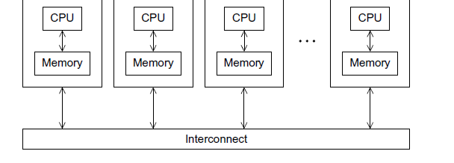
Message Passing interface

Slide 4
Core MPI Functions
Most MPI programs can be written using just these six core functions:
MPI_Init
int MPI_Init(int *argc, char ***argv)
initialize the MPI library (must be the first routine called)
MPI_Comm_size
int MPI_Comm_size(MPI_Comm comm, int *size)
get the size of a communicator
MPI_Comm_rank
int MPI_Comm_rank(MPI_Comm comm, int *rank)
get the rank of the calling process in the communicator

Slide 5
Core MPI Functions
MPI_Send
int MPI_Send(const void *buf, int count, MPI_Datatype datatype, int dest, int tag, MPI_Comm comm)
send a message to another process
MPI_Recv
int MPI_Recv(void *buf, int count, MPI_Datatype datatype, int source, int tag, MPI_Comm comm, MPI_Status *status)
receive a message from another process
MPI_Finalize
int MPI_Finalize()
clean up all MPI state (must be the last MPI function called by a process)

Slide 6
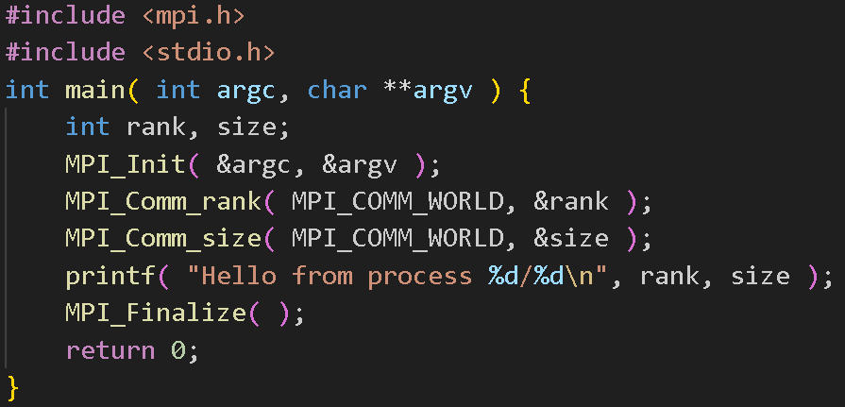
MPI Example

Slide 7
MPI Communication Functions
There are two types of communication functions in MPI
Blocking Communication Functions
Non-blocking Communication Functions

Slide 8
Blocking Communication Functions
Blocking communication are routines where the completion of the call is dependent on certain “events”.
For sends, the data must be successfully sent or safely copied to system buffer space and for receives, the data must be safely stored in the receive buffer.
Generally, this should be the go-to option for direct communication.

Slide 9
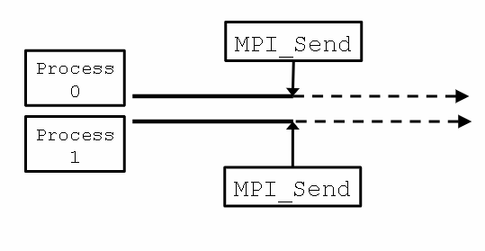
The functions are as follows:
MPI_Send(void* buf, int count, MPI_Datatype datatype, int dest, int tag, MPI_Comm comm)
MPI_Recv(void* buf, int count, MPI_Datatype datatype, int source, int tag, MPI_Comm comm, MPI_Status *status)

Slide 10
STATUS OBJECT
The status object is used after completion of a receive to find the actual length, source, and tag of a message.
Status object is MPI-defined type and provides information about:
The source process for the message (status.MPI_SOURCE)
The message tag (status.MPI_TAG)
Error status (status.MPI_ERROR)
The number of elements received is given by:
MPI_Get_count(MPI_Status *status, MPI_Datatype datatype,int *count)
status - return status of receive operation
datatype - datatype of each receive buffer element (handle)
count - number of received elements (integer)(OUT)

Slide 11
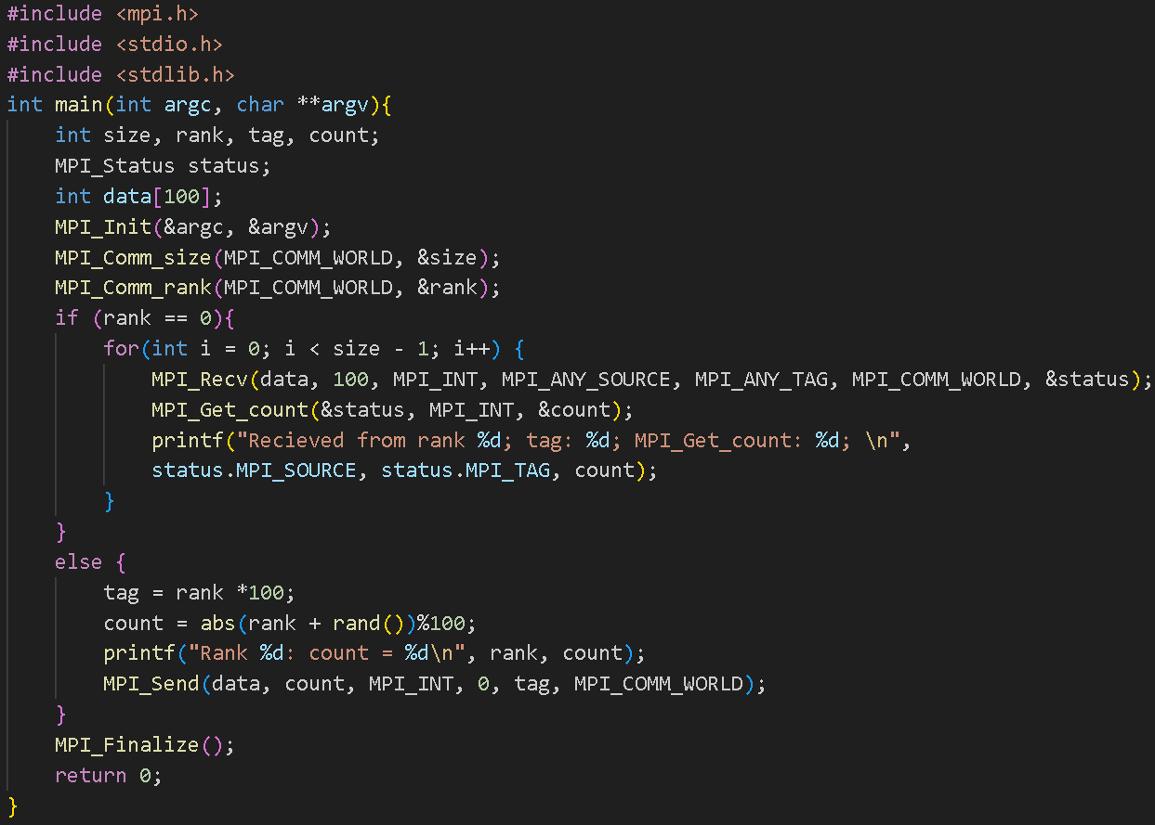
Example Using the “status” object

Slide 12
Non-blocking Communication Functions
A communication routine is non-blocking if the call returns without waiting for the communications to complete.
It is the programmer’s responsibility to insure that the buffer is free for reuse.
These are primarily used to increase performance by overlapping computation with communication.
It is recommended to first get your program working using blocking communication before attempting to use non-blocking functions.

Slide 13
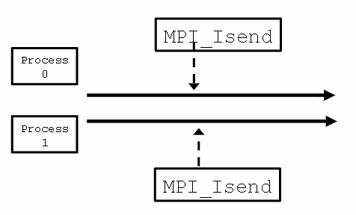
The functions are as follows:
MPI_Isend(void* buf, int count, MPI_Datatype datatype, int dest, int tag, MPI_Comm comm, MPI_Request *request)
MPI_Irecv(void* buf, int count, MPI_Datatype datatype, int source, int tag, MPI_Comm comm, MPI_Request *request)

Slide 14
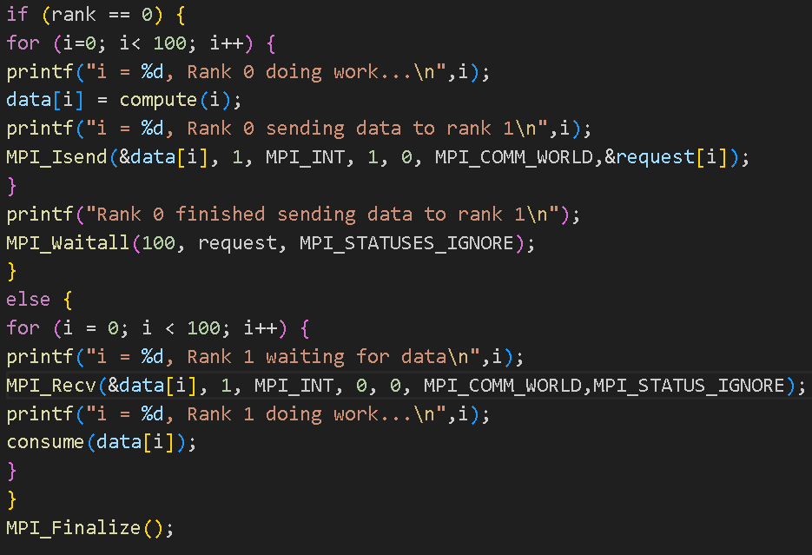
Non-blocking Communication Example

Slide 15
Data movement (Collective Communication)
MPI_Bcast: Broadcast sends a message from the process with rank “root” to all other processes in the group.
MPI_Scatter: The scatter operation performs a one-to-all communication. It splits the message into n equal segments with the ith segment sent to the ith process in the group
MPI_Gather: This function is the logical opposite to MPI_Scatter, it performs an all-to-one communication where a total of n data items are collected at a single process for all of the other processes.
MPI_Alltoall: This function is an all-to-all version of MPI_Scatter, where every process is sending and receiving n data segments
MPI_Alltoallv: This is a generalization of MPI_Alltoall where each process sends/receives a customizable amount of data to/from each process.

Slide 16
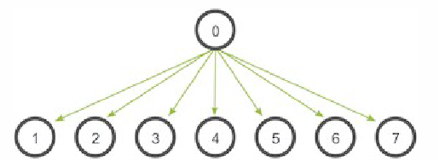
Broadcasting with MPI
A broadcast is one of the standard collective communication techniques.
During a broadcast, one process sends the same data to all processes in a communicator.
One of the main uses of broadcasting is to send out user input to a parallel program, or send out configuration parameters to all processes.

Slide 17
MPI_Broadcast
The function for broadcast in MPI is MPI_Bcast()
MPI_Bcast(void* data, int count, MPI_Datatype datatype, int sender, MPI_Comm communicator)
Although the root process and receiver processes do different jobs, they all call the same MPI_Bcast function.
When the root process calls MPI_Bcast, the data variable will be sent to all other processes.
When all of the receiver processes call MPI_Bcast, the data variable will be filled in with the data from the root process.

Slide 18
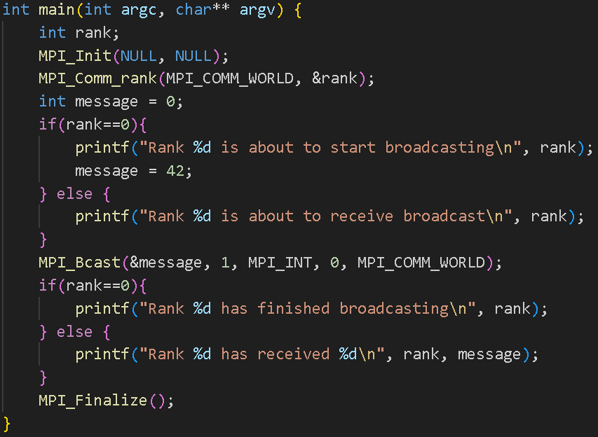
MPI_Broadcast Example

Slide 19
Synchronization (Collective Communication)
Processes wait until all members of the group have reached the synchronization point.
The function used to do this is:
MPI_Barrier (comm)
This causes each process, when reaching the MPI_Barrier call, to block until all tasks in the group reach the same MPI_Barrier call.

Slide 20
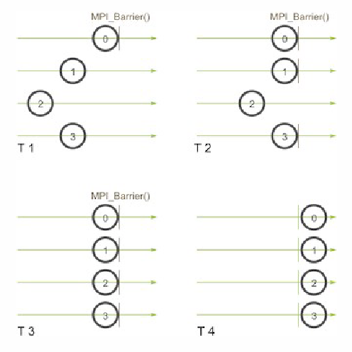
Synchronization (Collective Communication)
MPI_Barrier(MPI_Comm comm)

Slide 21
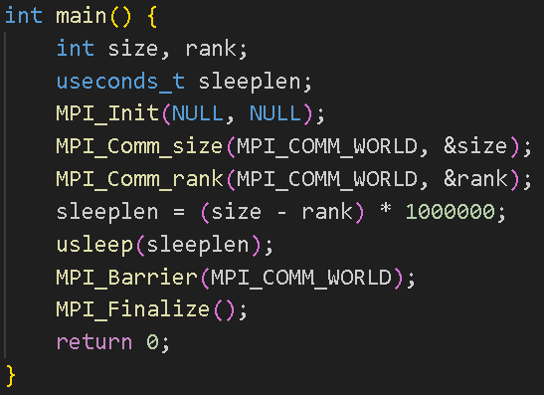
Synchronization Example

Slide 22
Reductions (Collective computation)
One member of the group collects data from the other members and performs an operation (min, max, add, multiply, etc.) on that data.
The function to do this is:
MPI_Reduce
One of the parameters of this function is the operation to be performed. Examples of this are: MPI_MAX, MPI_MIN, MPI_SUM, MPI_PROD, etc.

Slide 23
